Slide 1
Reducing The Risk Presentation
Sexual Health Education

Slide 2
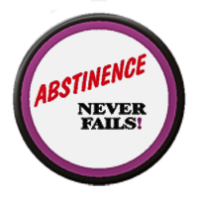
ABSTINENCE
Abstinence is an equal opportunity behavior.
Anyone can make a conscious choice to not have sex.
Abstinence is a thoughtful choice reflecting personal values.
Abstinence is an expression of personal power and self confidence.
Making decisions that are complex and challenging can make a person stronger.

Slide 4

2015 Youth Risk Behavior Surveillance System
Percentage of High School Students Who Ever Had Sexual Intercourse, by Sex,* Grade,* and Race/Ethnicity,* 2015
According to the 2015 Youth Risk Behavior Study, nationwide approximately 59% of 9th-12th graders have NOT had sex.

Slide 5
2016 MN Student Survey
90% of 9th grade females and 87% of 9th grade males have NOT had sex.
65% of 11th grade females and 64% of 11th grade males have NOT had sex.

Slide 6
Research on Sexual Activity
Research shows that the perception of students thinking that everyone’s doing it is higher than the actual number
Studies report that students who are sexually active, may also be more connected to other risk behaviors (alcohol and drug use) have trouble paying attention, concentrating and learning. In addition, the added stress of anxiety of a potential pregnancy, or having an STI may also make it difficult to concentrate or care in the classroom; and may also cause some students to withdraw, or drop out.

Slide 7

ARE YOU READY FOR SEX? ask yourself……
Am I pressuring my partner?
Who am I doing this for?
Does it go along with my values of waiting until marriage?
Do I only feel the desire to have sex when I am drunk or high?
Am I having sex to keep my partner or to make him or her happy?
What could I gain or lose from having sex?
If the relationship breaks up, will I be glad I had sex with this person?
Do my partner and I share the same feelings and attitudes about the meaning of sex and relationships?
Am I ready to deal with a possible pregnancy or STI?
Am I being pressured to do it?

Slide 8

RELATIONSHIP STEPS
1. Meet-Talk-Exchange #’s: “Interest”
2. Talk-Share-Friendship: “Trust”
3. Date-Talk- “Trust/Respect”
4. Date 1:1-exclusive: “Commitment”
5. Feelings- “Trust/Respect”
6. Express Sexuality- “Hugs & Kisses”
7. “Sexual Intercourse”

Slide 9
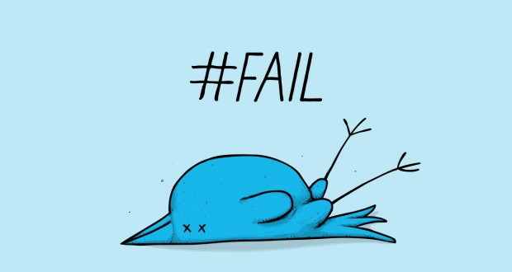
99 % of relationships fail when they do not follow those steps.
99%

Slide 10


99% of relationships succeed when they follow the steps.

Slide 11



SEXUALITY CIRCLE
Your sexuality involves all of you!
Heart
Spirit
Mind
Body

Slide 12
*C.P.R’s of
Successful Relationship
Communication that is STRONG and HONEST so there is no doubt about what you mean.
Planning for your future to make it healthy and happy.
Relationship Building: Respecting your partner and reassuring that you care about them.

Slide 14

SEX HAS CONSEQUENCES
Nearly 4 in 10 women become pregnant at least once before age 20- almost one million each year.
Nearly 2/3 of teens who have had sex wish they waited.
80% of teens say they feel pressure to have sex.
Teens say parents influence their decision-making more than any other source.
Nearly all teen pregnancies are unintended.
The U.S. has the highest teen pregnancy rate of all industrialized nations.

Slide 15

Approximate Worldwide Sexual Behaviors:
340,000,000 - cases of curable STI’s
occur every year.
500,000 young people infected w/an
STI every day
550,000 – pregnancies
360,000 – births
140, 000 - abortions
15,000 - cases of HIV infections
7,700 - deaths from AIDS
1,600 - deaths from childbirth complications
500 - deaths from STI’s
Source: United Nations population Fund. http://www.poodwaddle.com/worldclock/reg1/

Slide 16

Health benefits of postponing sex
Abstinence is the only 100% effective method of preventing HIV, STI’s, and unplanned pregnancies.
Teenage girls who are sexually active have an increased risk of cervical cancer.
Postponing sex allows you time to make decisions you can live with.

Slide 17
HPV: Human Papilloma Virus
Genital Warts (Viral)
Most common form of viral STI in U.S. (chlamydia is the most common bacterial STI in the US)
Close to 1,000,000 cases every year in the U.S. & most of these found in teenagers
Warts appear in clusters in contact area
Itching & burning sensation around the warts
You have the virus for life
Linked with cervical cancer
Treatment: warts can be removed but will probably appear again

Slide 18
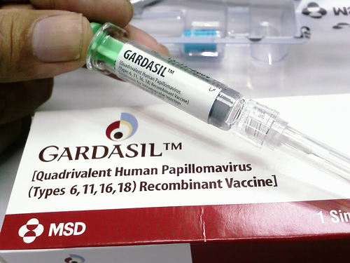
HPV VACCINE
The vaccine Gardasil®, protects against 4 HPV types, which together cause 70% of cervical cancers & 90% of genital warts.
The FDA licensed this vaccine for use in girls/women, ages 9-26. It is also recommended by for boys at age 11-12 years old. The vaccination of boys is also likely to benefit girls by reducing the spread of HPV viruses.
The vaccine is given in a series of three shots over a six month period.

Slide 19
Pap Smear
A Pap Smear checks for changes in the cells of your cervix. It can tell if you have an infection, abnormal (unhealthy) cervical cells, or cervical cancer.
A Pap Smear can save your life. It can find the earliest signs of cervical cancer. If caught early, the chance of curing cervical cancer is very high. A Pap Smear can also find infections and abnormal cervical cells that can turn into cancer cells. Treatment can prevent most cases of cervical cancer from developing.
It is important for all women to have Pap Smears, along with pelvic exams, as part of their routine health care. You need a Pap Smear if you are 21 years or older.

Slide 20
Teen Pregnancy Test
Most high school students are having sex.
True or False

Slide 21
#1
FALSE
Not everyone is doing it. Recent data shows that half of high school students report having had sexual intercourse while half report they are virgins.

Slide 22
2. What is the only 100% effective way to prevent a pregnancy?
A. Birth Control Pills
B. Condoms
Spermicide
Abstinence
All of the above

Slide 23
#2
D. Abstinence
The only 100% way to be sure you can prevent pregnancy. No contraceptive method is 100% effective except abstinence.

Slide 24
3. If you don’t use any form of contraception when you have sex, what are your chances of becoming pregnant within one year?
28% C. 76%
85% D. 43%

Slide 25
#3
        B. 85%

Slide 26
4. Do most teens who have sex wish they had waited?
Yes or No

Slide 27
#4
Yes. The poll conducted by National Campaign, 63% of teens who have had sexual intercourse said they wish they had waited.

Slide 28
5. How many girls become pregnant at least once before age 20?
1 in 10
3 in 10
4 in 10
7 in 10

Slide 29
#5
C. 4 in 10
Almost one million a year.

Slide 30
6. What is the percentage of teen mothers that get their high school diploma?
25%
32%
50%
72%

Slide 31
#6
B. 32%
Less than one-third of teens who have children before age 18 ever get their high school diploma.

Slide 32
7. About 50% of the fathers marry the teen mothers of their first children.
True or False

Slide 33
#7
False
About 20% of the fathers marry the teen mothers of their first children. On average, the remaining 80% pay less than $800 annually for child support-that is less than $16 a week.

Slide 34
8. What percent of pregnancies among teens are accidental?
25%
45%
65%
85%

Slide 35
#8
D. 85%
The vast majority- 85% unplanned and 79% to unmarried teens.

Slide 36
9. You can get a STI from having oral sex.
True or False

Slide 37
#9
True
As well as other forms of sexual activity.

Slide 38
10. The daughters of teen mothers are more likely to become teen mothers themselves.
True or False

Slide 39
#10
True
The daughter of teen mothers are 22% more likely to become teen mothers themselves. In addition, the children of teen mothers are at greater risk of abuse and neglect than children born to older parents

Slide 40
Sources cited on the web site: www.teenpregnancy.org

Slide 41
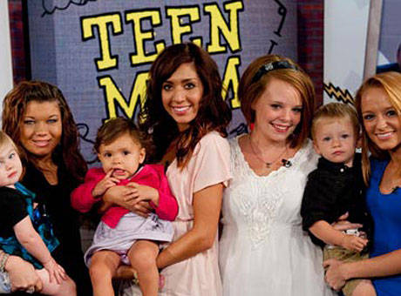
Teen Mom’s will usually…
Drop out of school.
Never be able to earn a decent living.
Be on welfare most of their life.
Be abandoned by the fathers of their babies.
Contribute disproportionately to cases of child abuse and delinquency.

Slide 42



Teen pregnancy is associated with lower levels of the 3 E’s.
LESS Education
LESS Employment
LESS Enjoyment

Slide 44


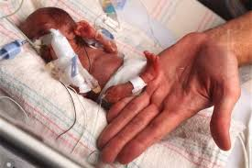
Teen moms experience more health risks during pregnancy than older moms .
Anemia= low red blood cell count, low hemoglobin causes like iron deficiency, ulcers, etc...
Toxemia= pregnancy induced hypertension (high blood pressure)
Premature delivery
Mortality
Cervical trauma
Source: NIDA: Addiction Research Foundation Library Publishers

Slide 45
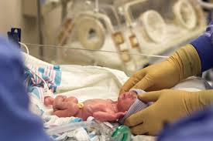
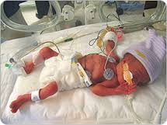
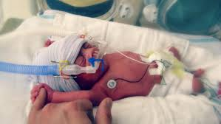
Infants born to teen mothers are at a greater risk of:
Prematurity
Fragile health
Need for intensive care
Cerebral palsy
Epilepsy
Mental impairments
Source: NIDA: Addiction Research Foundation Library Publishers

Slide 46
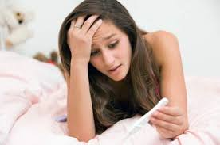
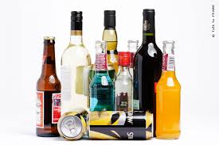
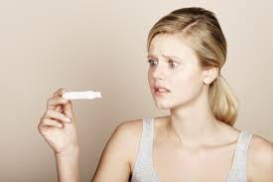
Facts on alcohol and teen pregnancy:
Many girls lose their virginity while drunk.
Unplanned pregnancies ages 14-21, 1/3rd of the girls who had gotten pregnant were drinking when they had sex.
Boys who start drinking at a young age are 40% more likely to have sex at a young age and girls are more susceptible at 80%.
F.A.S.D.

Slide 47

REFUSAL SKILLS:
1. SAY NO: “NO”
2. REPEAT THE REFUSAL: “I SAID NO”
3. SUGGEST AN ALTERNATIVE: “LETS GO TO A MOVIE”
4. USE BODY LANGUAGE THAT SAYS “NO”
5. BUILD THE RELATIONSHIP (IF APPROPRIATE). “ I STILL LIKE YOU A LOT AND THINK YOU’RE A GREAT PERSON.”
Jack & Jill Role Play #2: A 2nd Chance

Slide 48
TEEN DATING VIOLENCE
If you are a female dating right now, there is a 50-50 chance you’ll suffer some form of abuse by a dating partner.
Average age dating violence begins is 15
75% of boys who abuse their girlfriend are from homes where abuse occurred
68% of young women reporting rape were raped in dating relationships
1 out of 3 women murdered in the US are killed by a husband or boyfriend.
1 in 10 teens reported being hit or physically hurt on purpose by a boyfriend or girlfriend at least once in the 12 months prior to the survey
Nearly half of all teens in relationships say they know friends who have been verbally abused.

Slide 49
WARNING SIGNS that a dating partner may eventually become abusive include:
Extreme jealousy, monitors your every move
Blaming others for problems
Never able to admit wrongdoings
Cruelty to animals
Rigid beliefs about sex-roles
Controlling : makes all decisions and keeps you from seeing friends/family
Name calling, put-downs, make you feel bad about yourself
Threats
Violent behavior: slams doors, hits, punching walls,etc.
Tries to make up buy saying they are sorry, they love you, it will NEVER happen again and/or buying you flowers, jewelry

Slide 50

How do I get help??
Realize you are Not alone
Recognize signs & symptoms
See a counselor
Call a hotline: Alexandra House 24 hour crisis Line: (763)780-2330

Slide 51
The Sexual decisions YOU make today……will affect your
FUTURE!
3,ooo teens will get pregnant today!
Every 10 seconds, a teen will get an STI.
68% of teens stated that they choose to be virgins.
32% of condoms used within the last 16 days broke during use.
75% of women who have chlamydia don’t know they have it while it is destroying their bodies.
The younger a person is who chooses to engage in sexual behavior, the higher their risk of cancer. (Cervical, uterine, etc.)

Slide 52

Abstinence is a healthy CHOICE that you have the right to practice!

Slide 53
S.T.I. Rap
https://youtu.be/JVt_CZ1QI0k

